Slide 1
HDF 492
Portfolio
Luckson Omoaregba
Spring 2015
lomoaregba@my.uri.edu

Slide 2
Table of Contents
Introduction
Opening Statement
Content Overview
‘The Commencement’

Slide 3
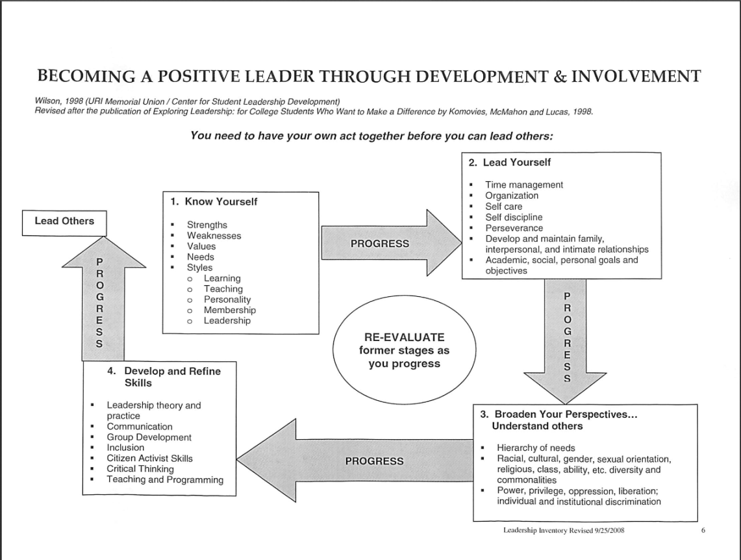

Slide 4
MUSIC
“One good thing about music, when it hits you, you feel no pain.”
― Bob Marley
“Music gives a soul to the universe, wings to the mind, flight to the imagination
and life to everything.”
― Plato
“Music expresses that which cannot be said and on which it is impossible to be silent.”
― Victor Hugo, Hugo's Works: William Shakespeare
“Music . . . can name the unnameable and communicate the unknowable.”
― Leonard Bernstein

Slide 5

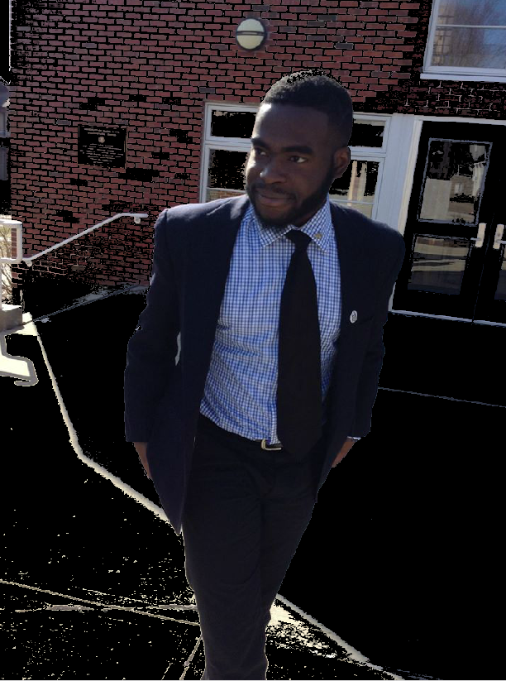
COMMENCEMNT

Slide 6

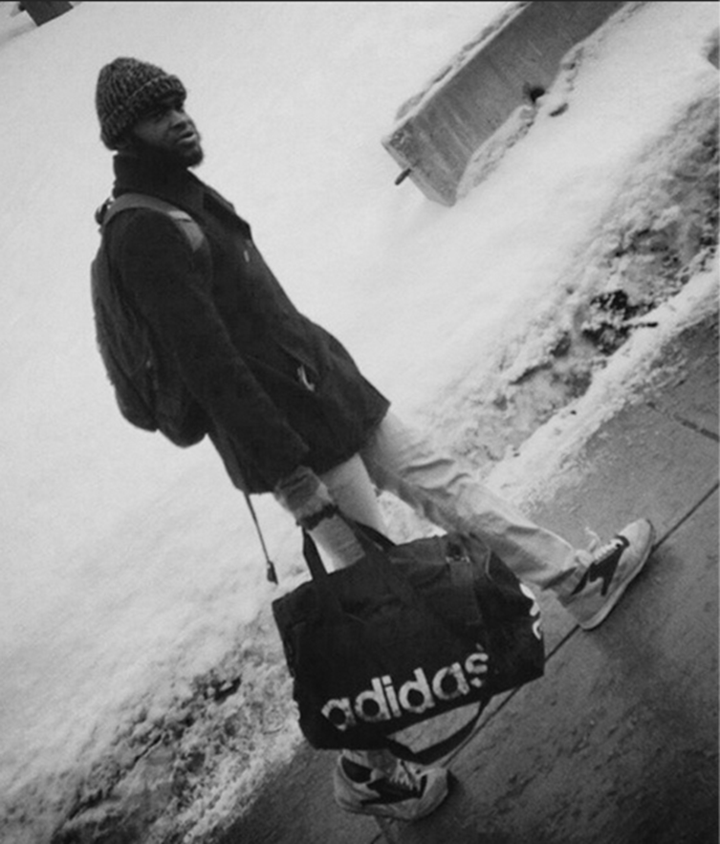
COMMENCEMNT
THE
THE
COMMENCEMNT
Evolution

Slide 7

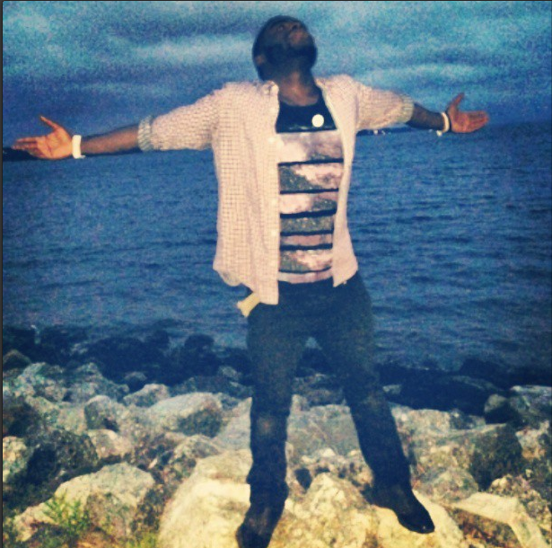

1.Self-Leadership
2.Leadership Theories.
3.Inclusive Leadership/ Diversity and its application to leadership.
4.Critical Thinking.
5.Interpersonal and Organizational Concepts & Skills.

Slide 8

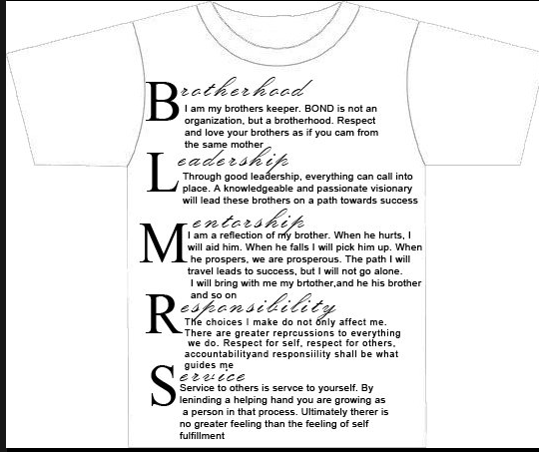
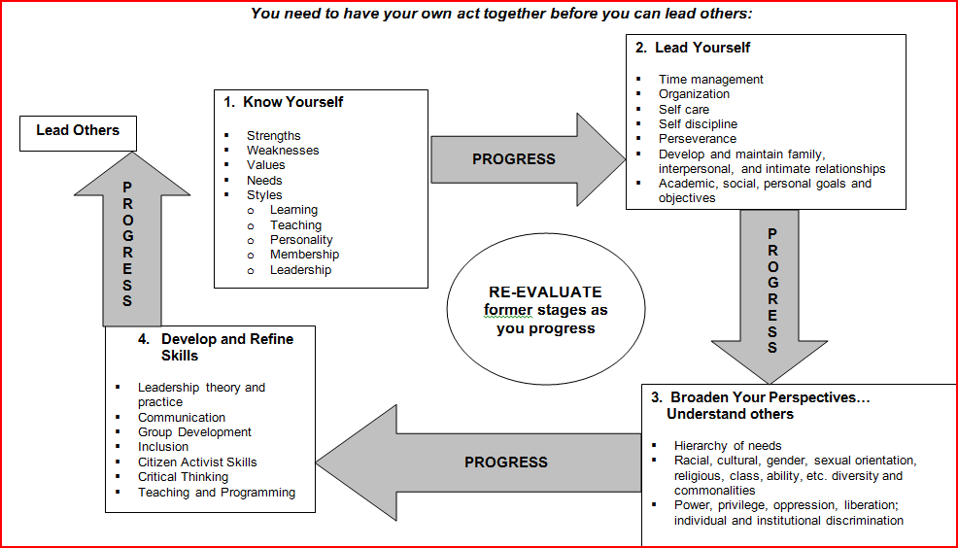
Self Leadership
Context
Belief Communication
Harmony
Positivity

Slide 9
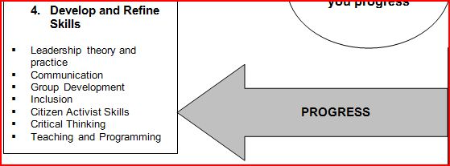

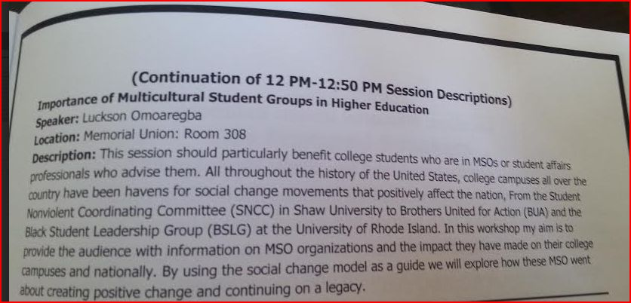
Leadership Theories

Slide 10
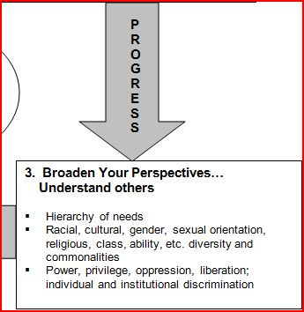

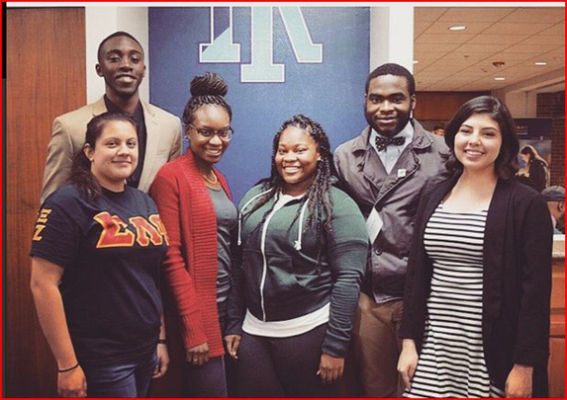

Inclusive leadership/ Diversity and its application to leadership

Slide 11
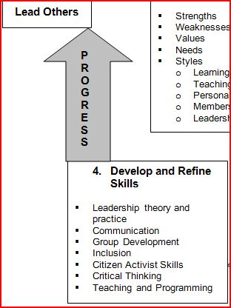
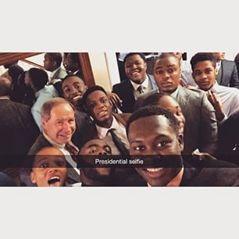
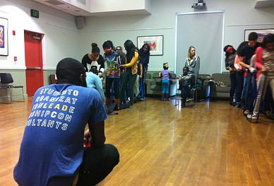
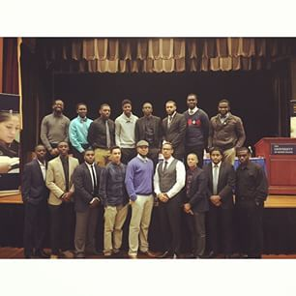
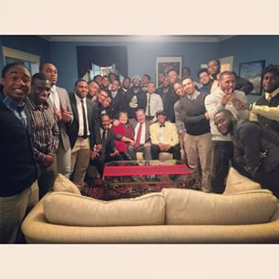

Critical Thinking

Slide 12
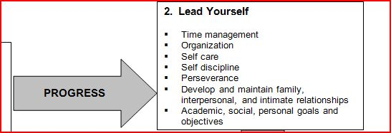



Interpersonal and Organizational concepts and skills

Slide 13

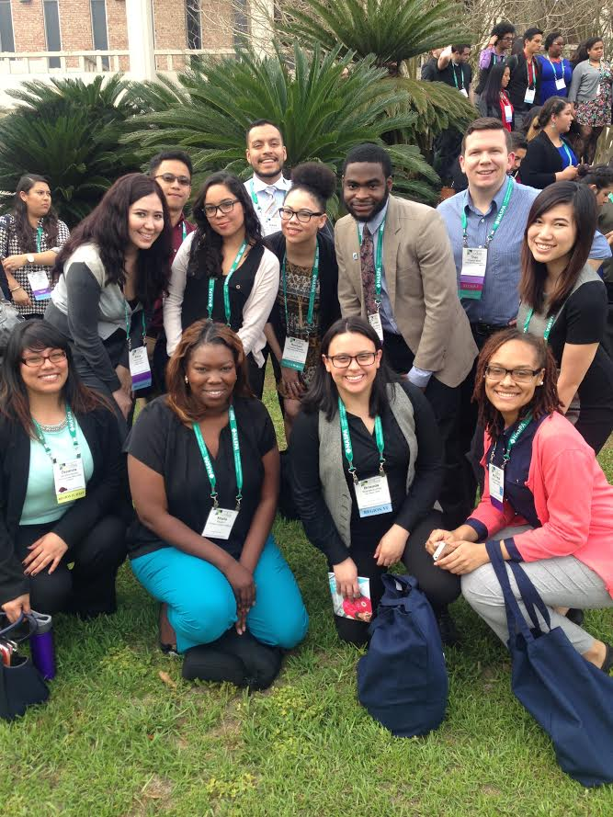
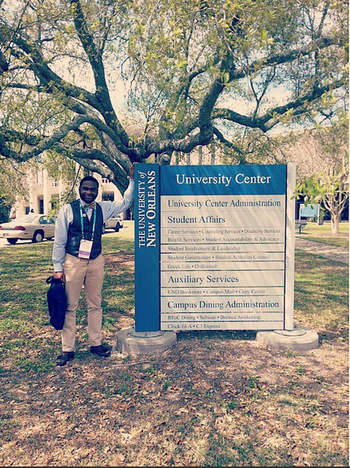
NASAP/NUFP (Student Affairs)

Slide 14
Questions?

